Slide 1



SMART INDIA HACKATHON 2025
TITLE PAGE
Problem Statement ID - 26103
Problem Statement Title- Use case on
web-based integrated project-monitoring platform
Theme- Smart Automation
PS Category- Software
Team ID-
Team Name (Registered on portal)- CritiX

Slide 2
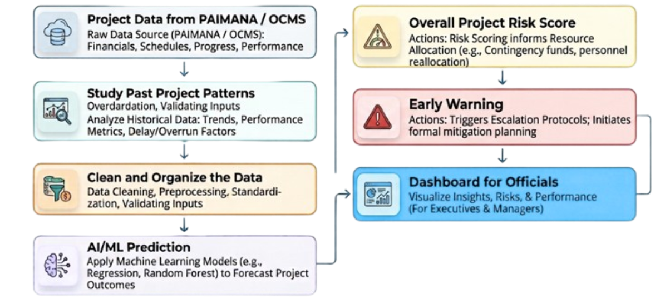

NIRIKSHAN AI
CriticX
Idea/Solution:
Our system uses AI/ML to enable predictive monitoring of infrastructure projects using OCMS and PAIMANA data.
It predicts potential cost and time overruns before they occur.
It generates a dynamic risk score based on key project performance indicators.
It provides early-warning alerts for projects at risk of delays or cost escalation.
It uses Explainable AI to identify the key factors behind each risk prediction.
It enables benchmarking and comparison of projects across sectors and agencies.
Unique Value Propositions (UVP):
Predict & Alert: Predicts cost/time risks and alerts officials early.
Explain & Prioritize: Scores risk, explains why, and highlights priority projects.
Learn & Act: Learns from past projects and suggests timely actions.
@SIH Idea submission- Template
2

Slide 3
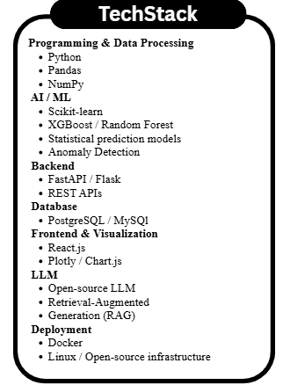
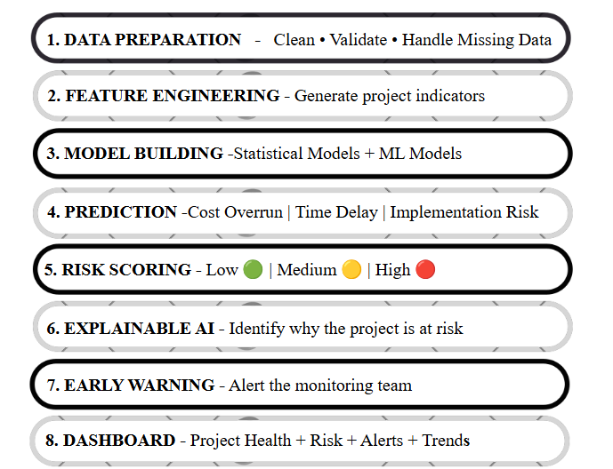








TECHNICAL APPROACH
CriticX
Very simple overall flow:
Data
Clean
Analyse
Predict
Score Risk
Explain
Alert
Dashboard
@SIH Idea submission- Template
3

Slide 4



FEASIBILITY AND VIABILITY
CritiX
Analysis of the feasibility of the idea
Technical: Uses PAIMANA data + AI/ML.
Financial: Uses low-cost open-source tools.
Market: Useful for MoSPI and government departments.
Operational: Simple dashboard for easy monitoring.
Scalable: Can cover more projects and sectors.
Strategies for overcoming these challenges
Data: Clean and verify data.
Models: Test and select the best model.
Accuracy: Update models regularly.
Trust: Show reasons behind predictions.
Alerts: Use proper risk levels.
Human + AI: Officials make the final decision
Potential challenges and risks
Technical: Incomplete or incorrect data.
Financial: Higher cost for large-scale data.
Market: User trust in AI predictions.
Operational: Need regular data updates.
AI: Wrong predictions or false alerts.
@SIH Idea submission- Template
4

Slide 5
IMPACT AND BENEFITS
CritiX
Potential Impact on Target Audience:
MoSPI / IPMD: Identify high-risk projects early.
Monitoring Officers: Get early alerts and risk reasons.
Ministries / Departments: Track project health and take timely action.
Decision Makers: Compare projects and prioritise resources.
Project Teams: Address risks before they become major issues.
Overall: Shift from reactive monitoring to proactive action.
Benefits of the Solution:
Social: Faster delivery of public infrastructure.
Economic: Early detection of cost increases and better use of public funds.
Governance: Faster, data-driven project monitoring.
Operational: Less manual effort in identifying high-risk projects.
Environmental: Reduce resource wastage from prolonged delays and rework.
Long-Term: Scalable monitoring across sectors and projects.
@SIH Idea submission- Template
5

Slide 6






RESEARCH AND REFERENCES
CriticX
1. MoSPI – Infrastructure & Project Monitoring Division (IPMD)
PAIMANA Project Monitoring Platform
https://ipm.mospi.gov.in/AboutUs/AboutIPMD
2. PAIMANA Public Dashboard
Project cost, expenditure, progress and sector-wise project information.
https://ipm.mospi.gov.in/Home/PublicDashboard
3. New OCMS – PAIMANA
Project monitoring, standardized metrics and time/cost-overrun monitoring.
https://ipm.mospi.gov.in/AboutUs/AboutOCMS
4. OCMS – MoSPI FAQ
Background and role of OCMS in Central Sector Infrastructure Project monitoring.
https://ipm.mospi.gov.in/FAQ/Index
5. Machine Learning & Model Evaluation
Scikit-learn documentation — model selection, cross-validation and prediction evaluation.
https://scikit-learn.org/stable/
6. XGBoost
Gradient-boosting methods for machine-learning based prediction.
https://xgboost.readthedocs.io/en/stable/
7. Explainable AI – SHAP
Used to understand which features contribute to an ML prediction. https://shap.readthedocs.io/en/latest/example_notebooks/overviews/An%20introduction%20to%20explainable%20AI%20with%20Shapley%20values.html
8. FastAPI
For building the backend APIs connecting the prediction system with the dashboard.
https://fastapi.tiangolo.com/
@SIH Idea submission- Template
6

